Slide 1

Real-Time Cloud Data Pipeline Airflow, Spark, Snowflake, and BigQuery for NYC Taxi data
Mega Project – Data Engineering
Prepared by: [Yousef Turky]

Slide 2
Project Objective
Design & implement a scalable pipeline to process and analyze data.
Use GCP cloud technologies to handle and automate pipelines.
Handle data in both streaming and batch modes.
Provide data profiling, cleaning, ETL, and analytics.

Slide 3
Table of contents
Tools & technologies
01
The Challenges
02
03
Solution approach
04
Solution Architecture
Batching Pipeline
Dataproc job
Streaming Pipeline
Pandas processing
Data Modeling
04
05
Analytics

Slide 4
Tools & Technologies
Pipeline automation– Cloud Composer(airflow)
Transformations & ETL – using Dataproc and Pandas
Data storage – BigQuery and Snowflake
EDA – Databricks/Power BI
code documentation – GitHub

Slide 5
The Challenges
Businesses face the challenges of processing vast amounts of data.
Data that flow continuously from various sources.
Utilizing available resources to scale up the system and avoid high latency and bottlenecks.

Slide 6
Solution approach
Use composer as orchestration and automation tool.
Implementing a Streaming Pipeline to process large amounts of data.
Implementing batching Pipeline to extract desired insights.
Use visualizations and BI tools to visualize, explore and analyze data.

Slide 7
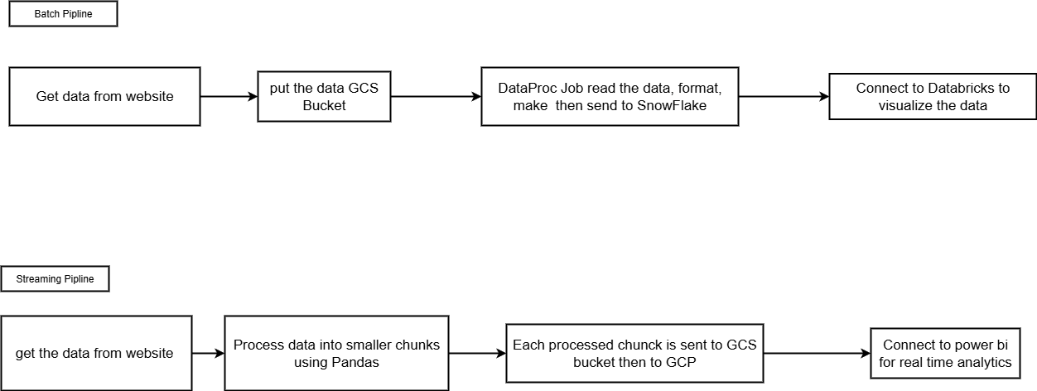
Solution Architecture

Slide 8
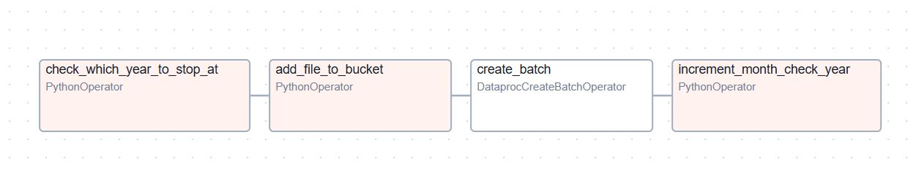
Batch pipeline

Slide 9

Dataproc Job
It is serverless so only allocate resources during job time.
Uses spark framework which elevate data processing.
Handle wrong values and null values.
Handle parquet format perfectly.
Able to connect to many databases using JDBC connectors.

Slide 10
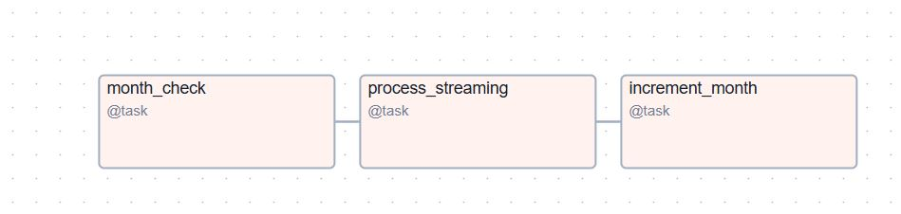
Streaming Pipeline

Slide 11

Pandas processing
Read incoming data into chunks to ease processing.
Process each chunk send to GCS bucket.
Adding row number for data as surrogate key.
Writing data to bigQuery in near real time.

Slide 12
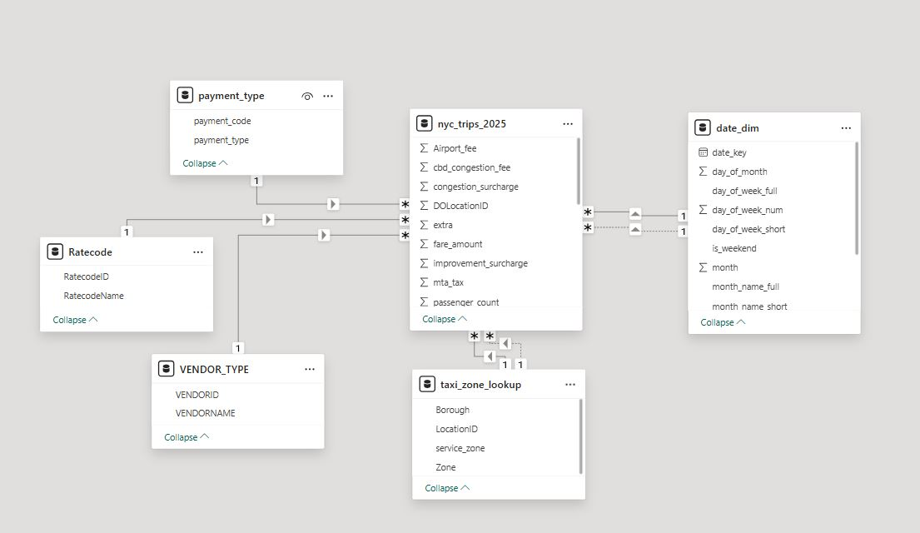
Data Modeling

Slide 13
Analytics and findings

Slide 14
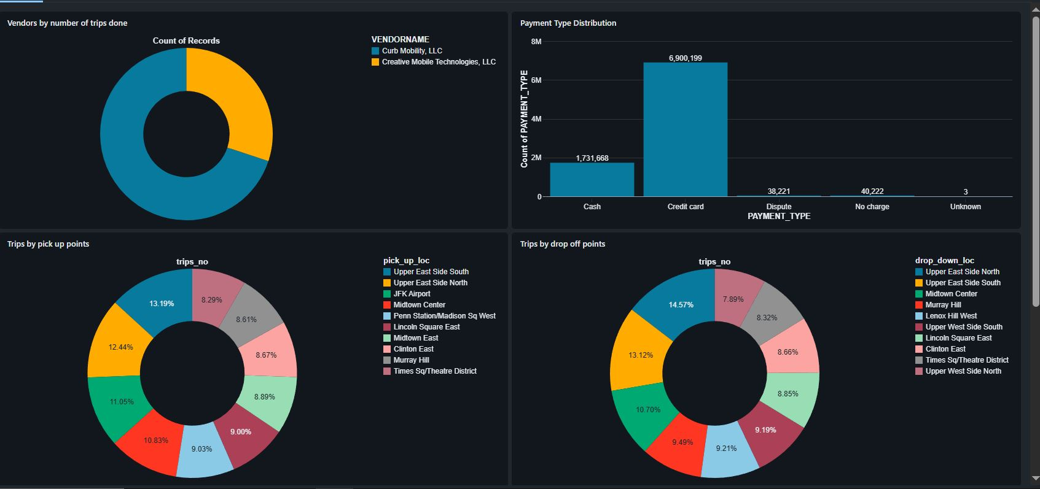
Deliverables for batch data

Slide 15
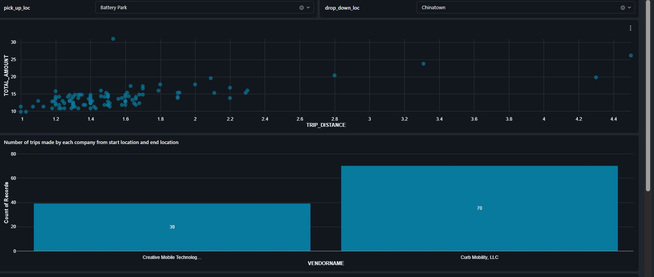
Deliverables for batch data

Slide 16
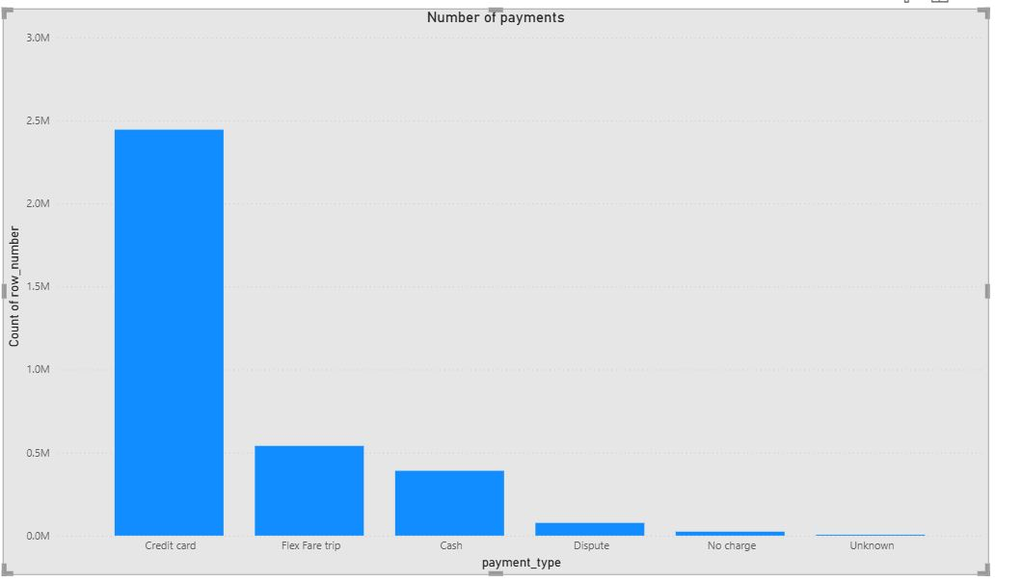
Deliverables for stream data

Slide 17
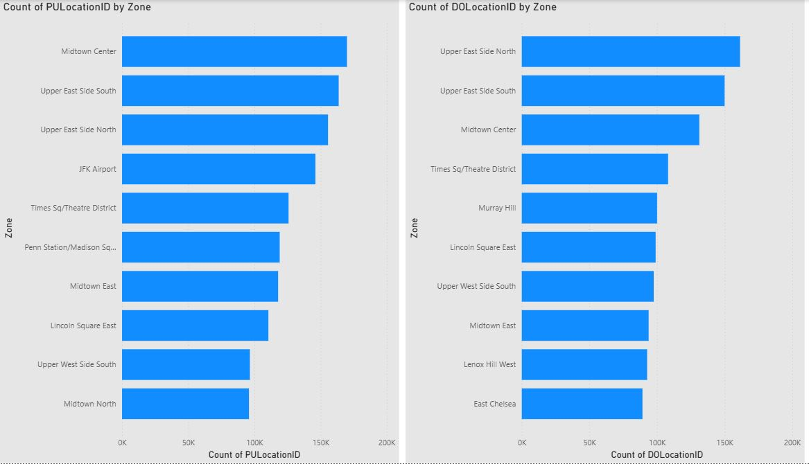
Deliverables for stream data

Slide 18
Summary
Building scalable pipeline using cloud capabilities.
Process data in both stream and batch modes.
Ability to Take decision based on historic data or in real time.

